Slide 1













Lab. Design the sequence detector
Design a circuit that detects a sequence of three consecutive 1’s in a string of bits coming from an input line
0. Word description and specify the desired operations

Slide 2
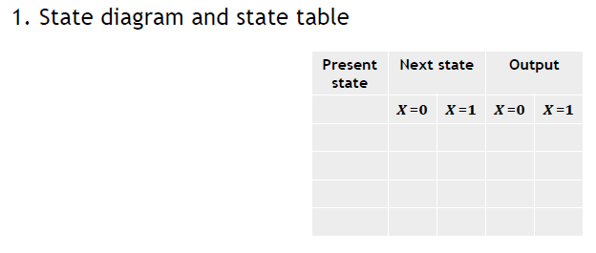
Lab. Design the sequence detector
Design a circuit that detects a sequence of three consecutive 1’s in a string of bits coming from an input line
First check point

Slide 3
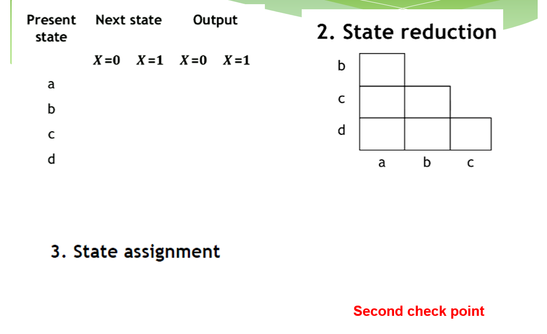
Use Binary code: 00,01,10,11

Slide 4
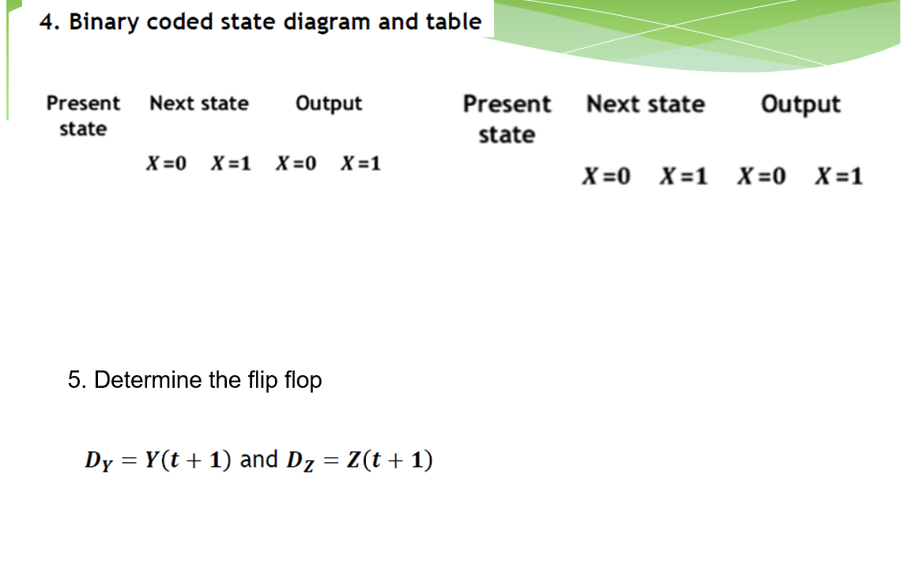


Slide 5
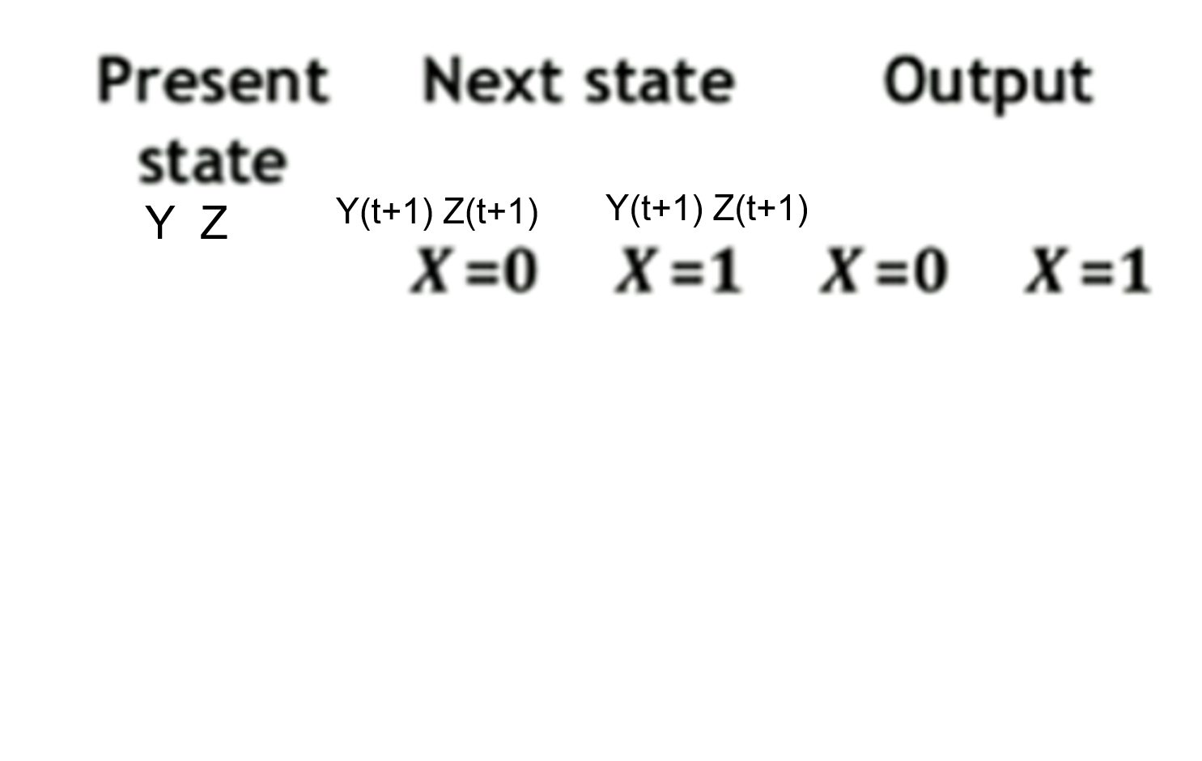


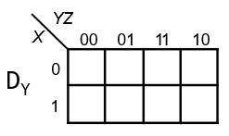
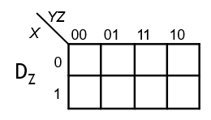
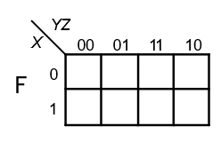
Third check point

Slide 6
Boolean expression
𝑫_{𝒀} =
𝑫_{𝒁} =
𝑭 =
7. Logic diagram

Slide 7
8. MATLAB simulation
Input x(pulse wave generator): Sample based, Amplitude is 1, period is 16, Pulse width is 4, Phase delay is 0, Sample time is 1.
Clock signal (pulse wave generator): Sample based, Amplitude is 1, period is 2, Pulse width is 1, Phase delay is 1, Sample time is 1.
!CLR of each D flip flop is connected to constant 1.
Simulation time is 20s.
Observe the result in the scope. Five ports: input signal, clock signal, output F

Slide 8
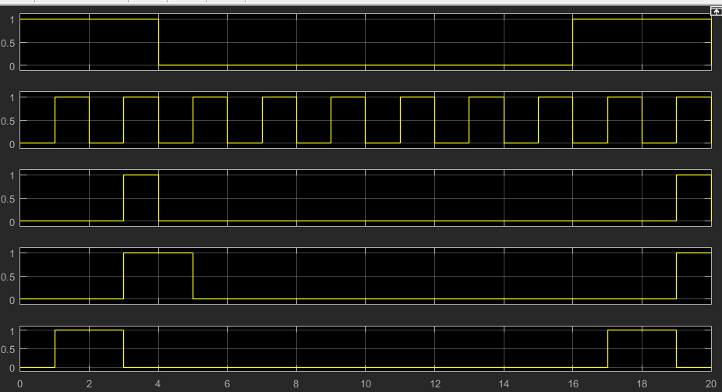
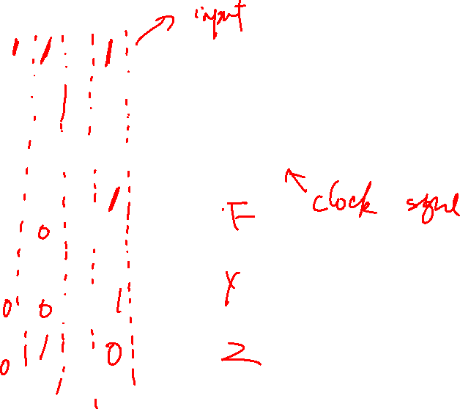
Fourth check point

